Slide 1
Chatbot using Azure Bot Service

Slide 2
The Azure Bot Service is powered by the Microsoft Bot Framework and bot service allows developers to build conversational applications that plug into many popular chat applications including Facebook Messenger, Skype and Office 365, etc. In this article, we can create and test a bot by using the Azure Bot Service.

Slide 3
Create a New Bot Service
Logon to the Azure Portal .
Click on Add → Data Analytics

Slide 4
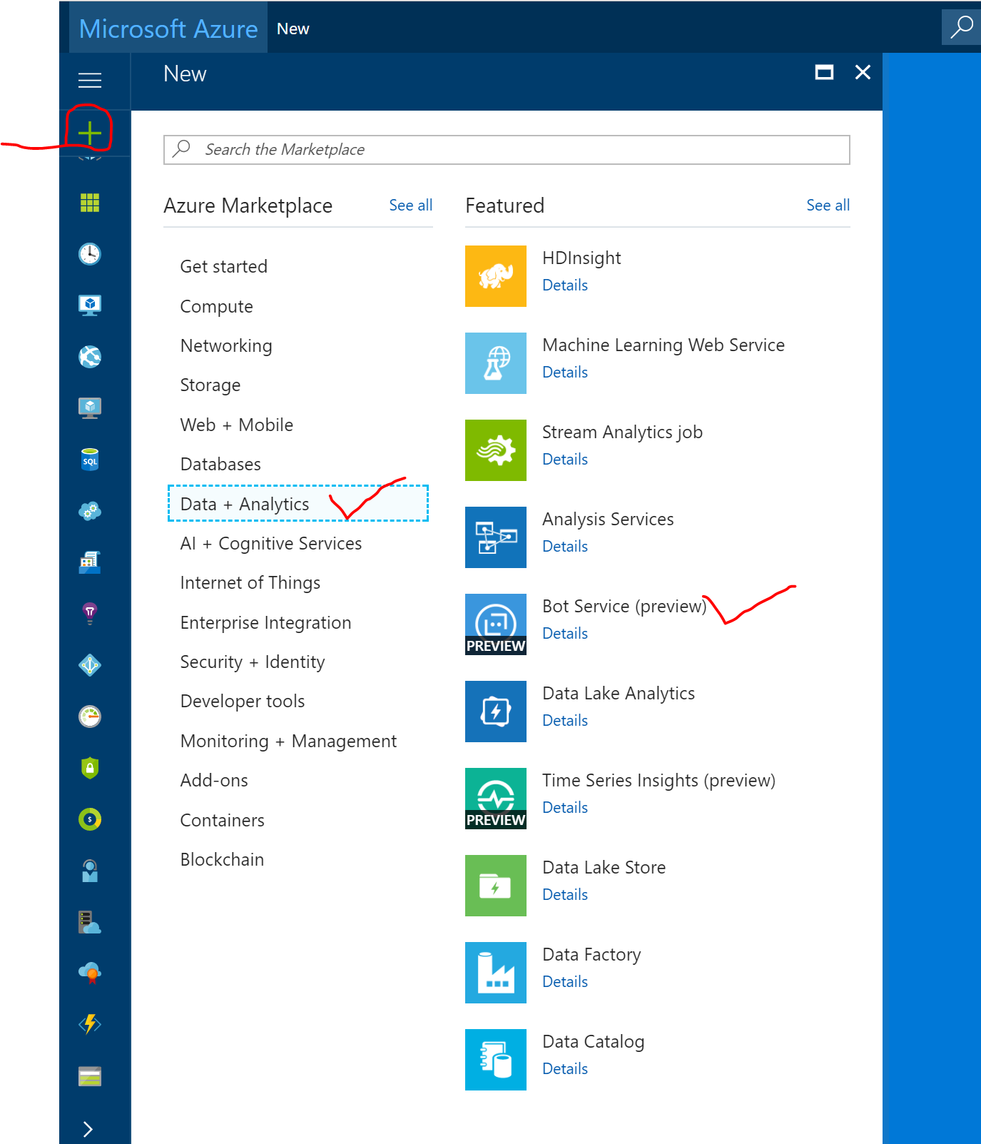

Slide 5
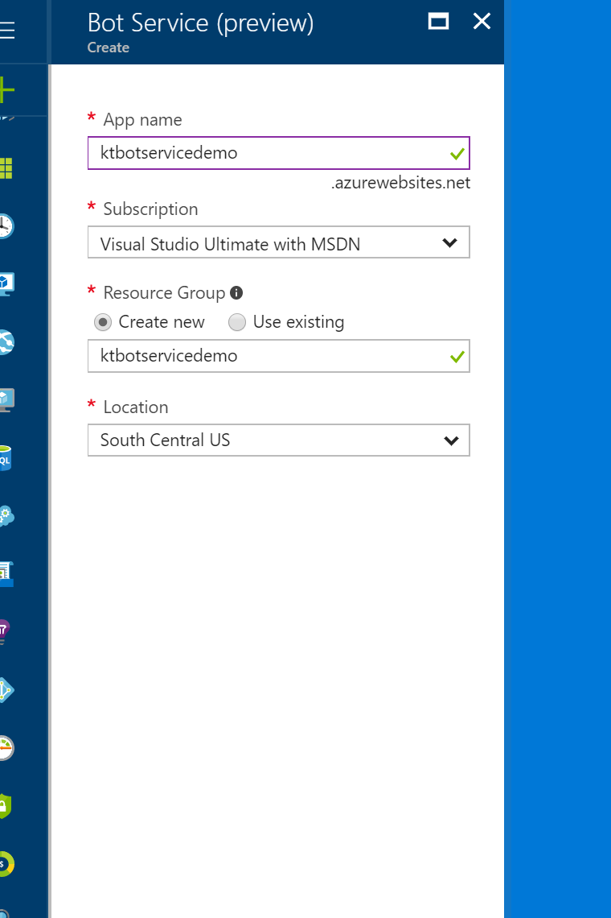

Slide 6
Once Bot service is created, Go to App Services and click on your newly created Bot Service.

Slide 7
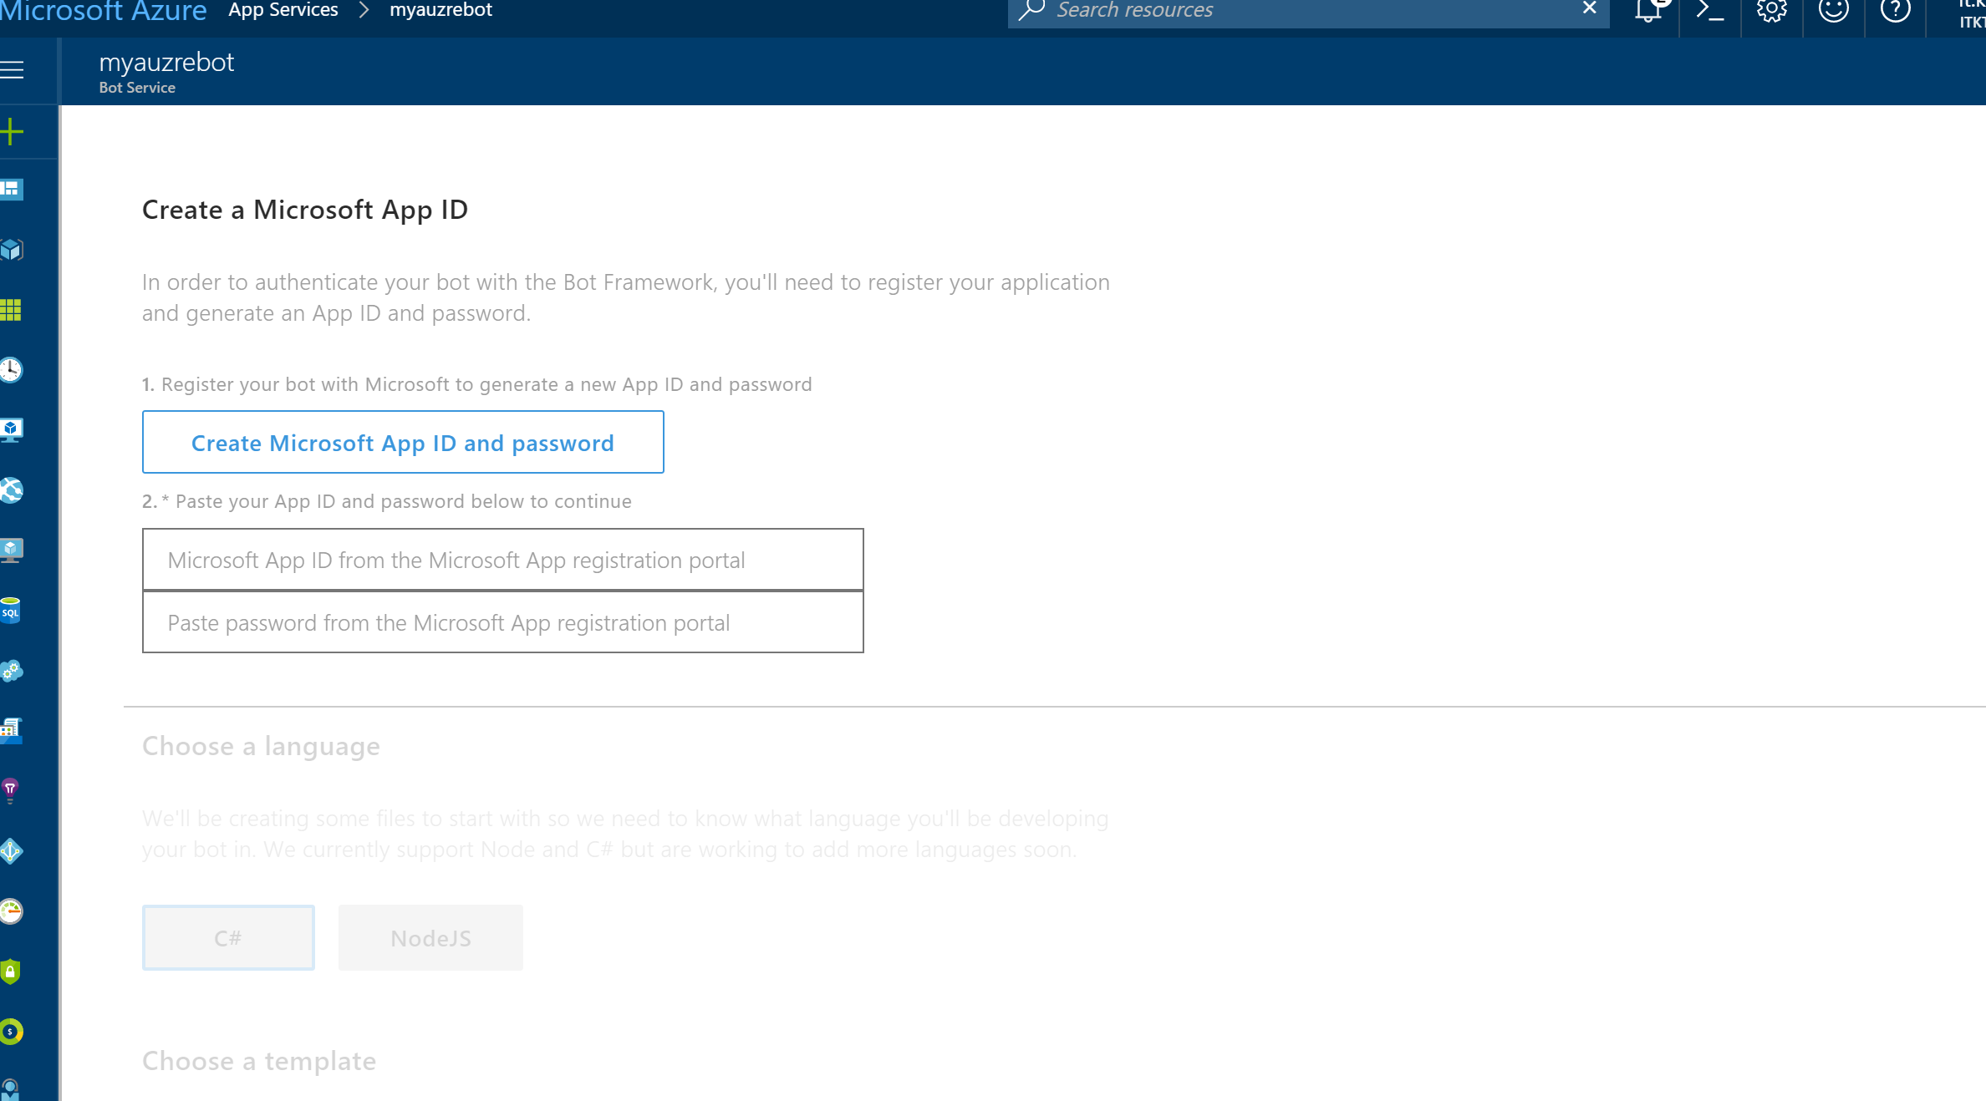
You will get below screen , where you need to create App ID and Password. This is mandatory to authenticate your bot with the Bot Framework.

Slide 8
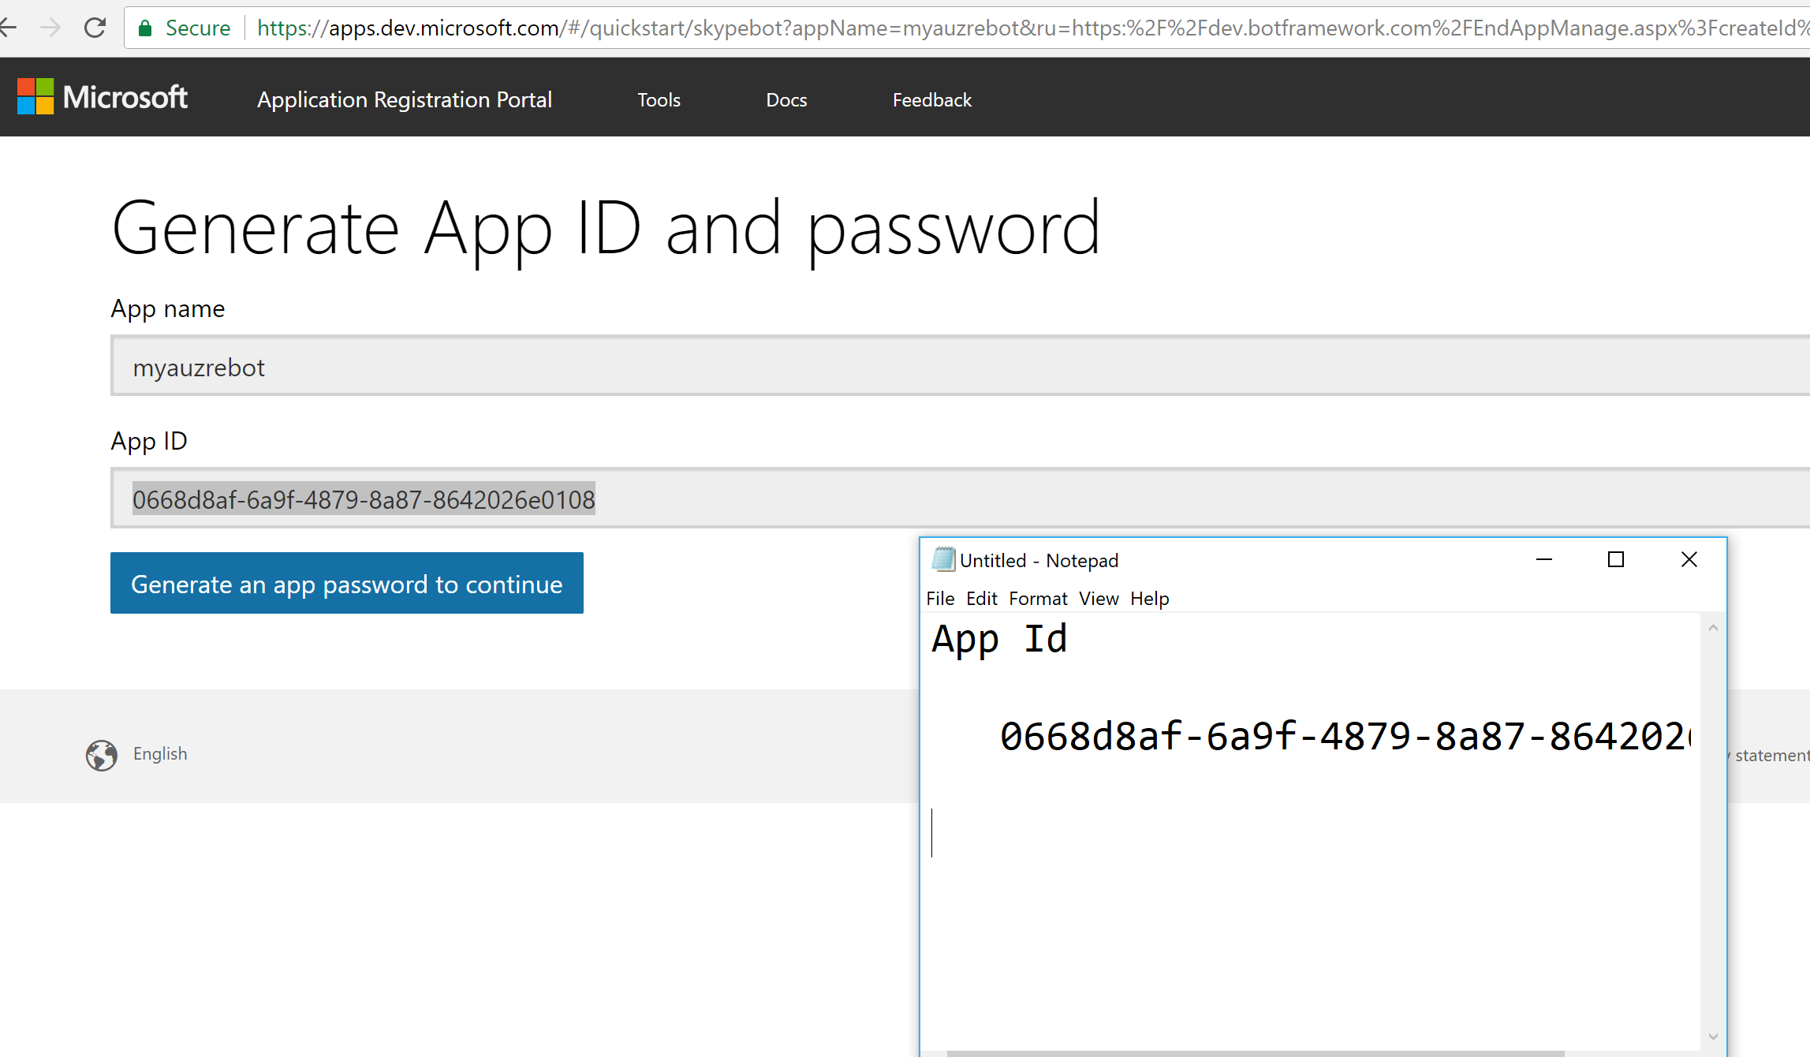
Copy App Id and Generate an app password

Slide 9
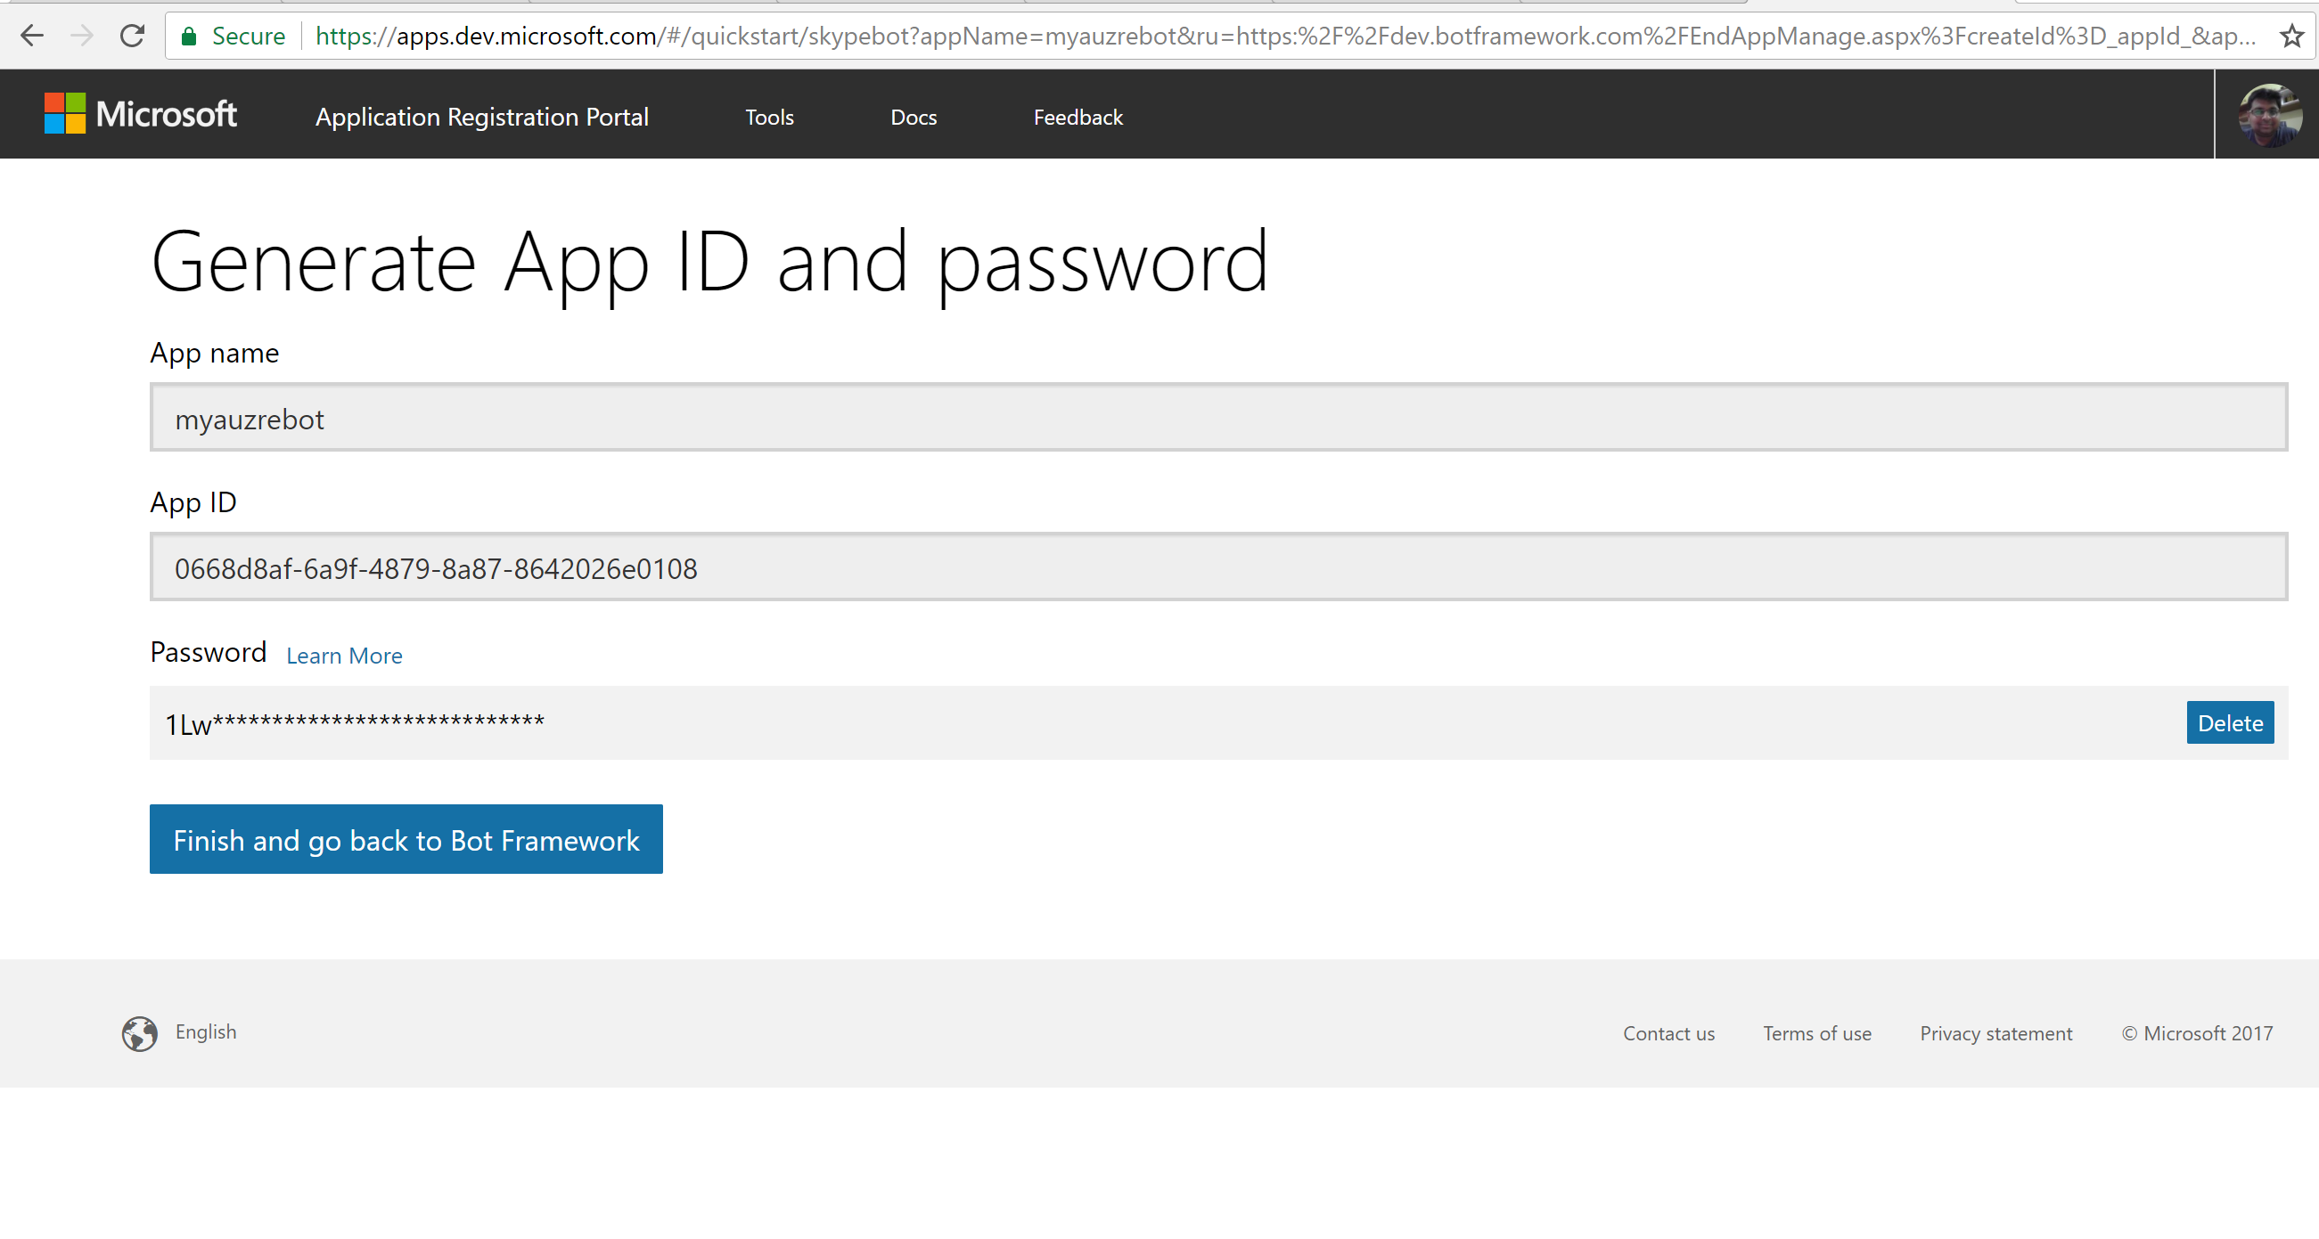
Finish ang Go back to Bot Framework

Slide 10
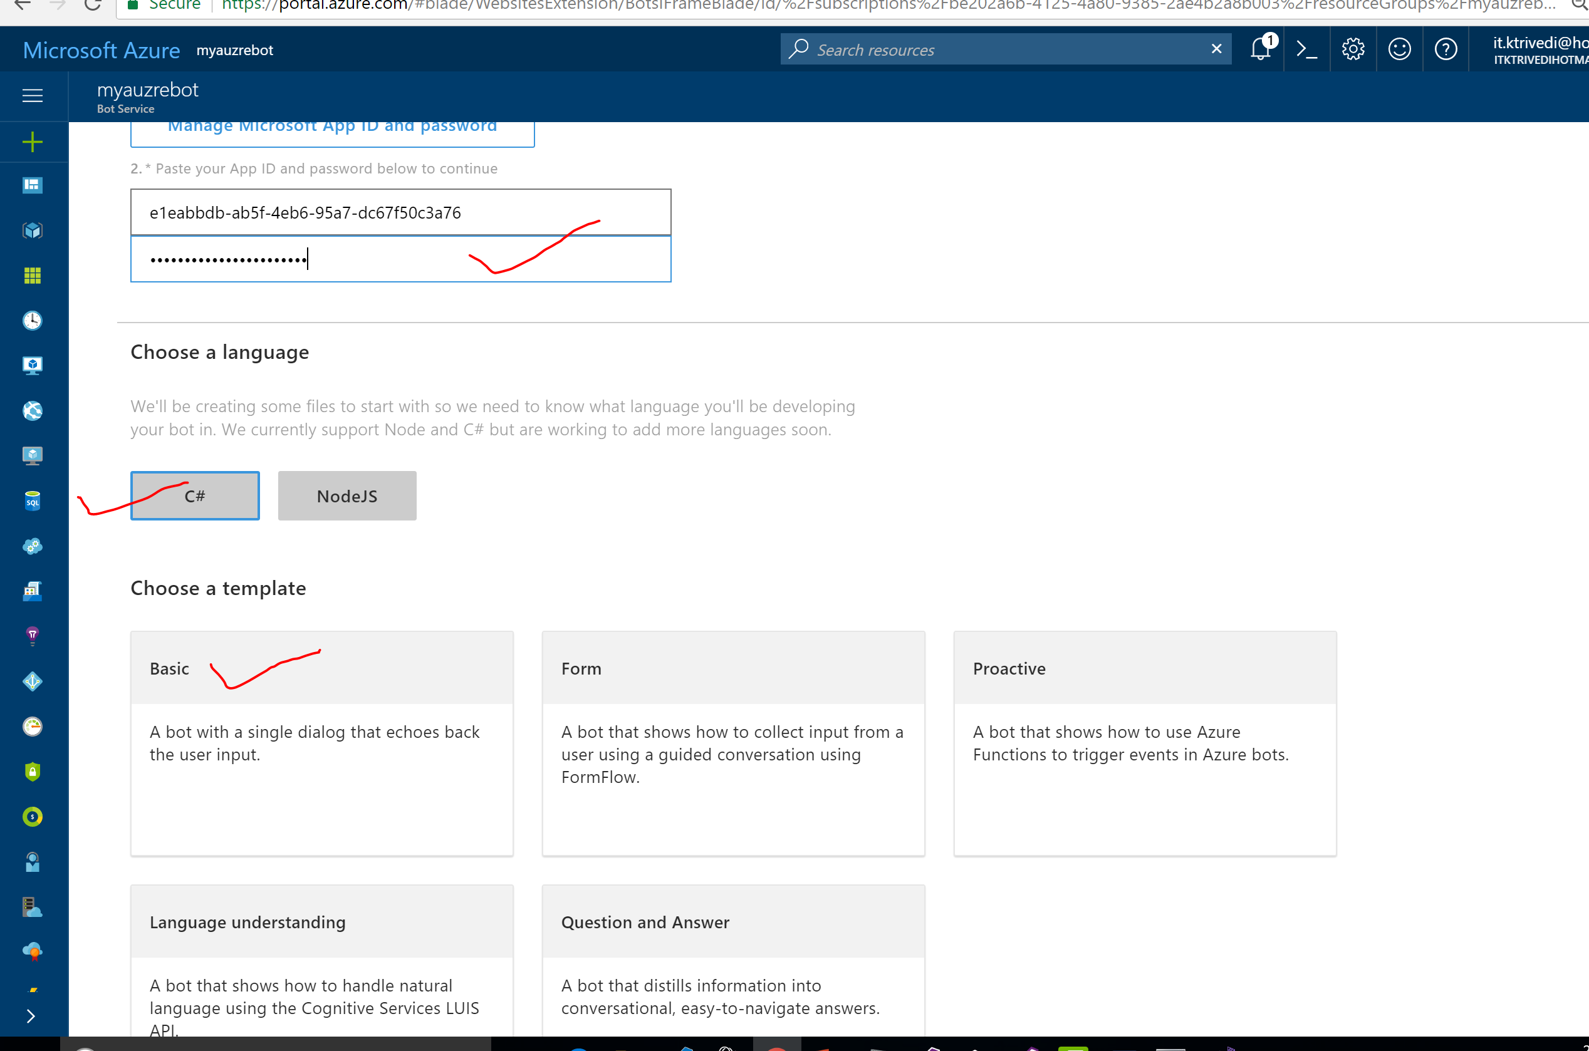

Slide 11
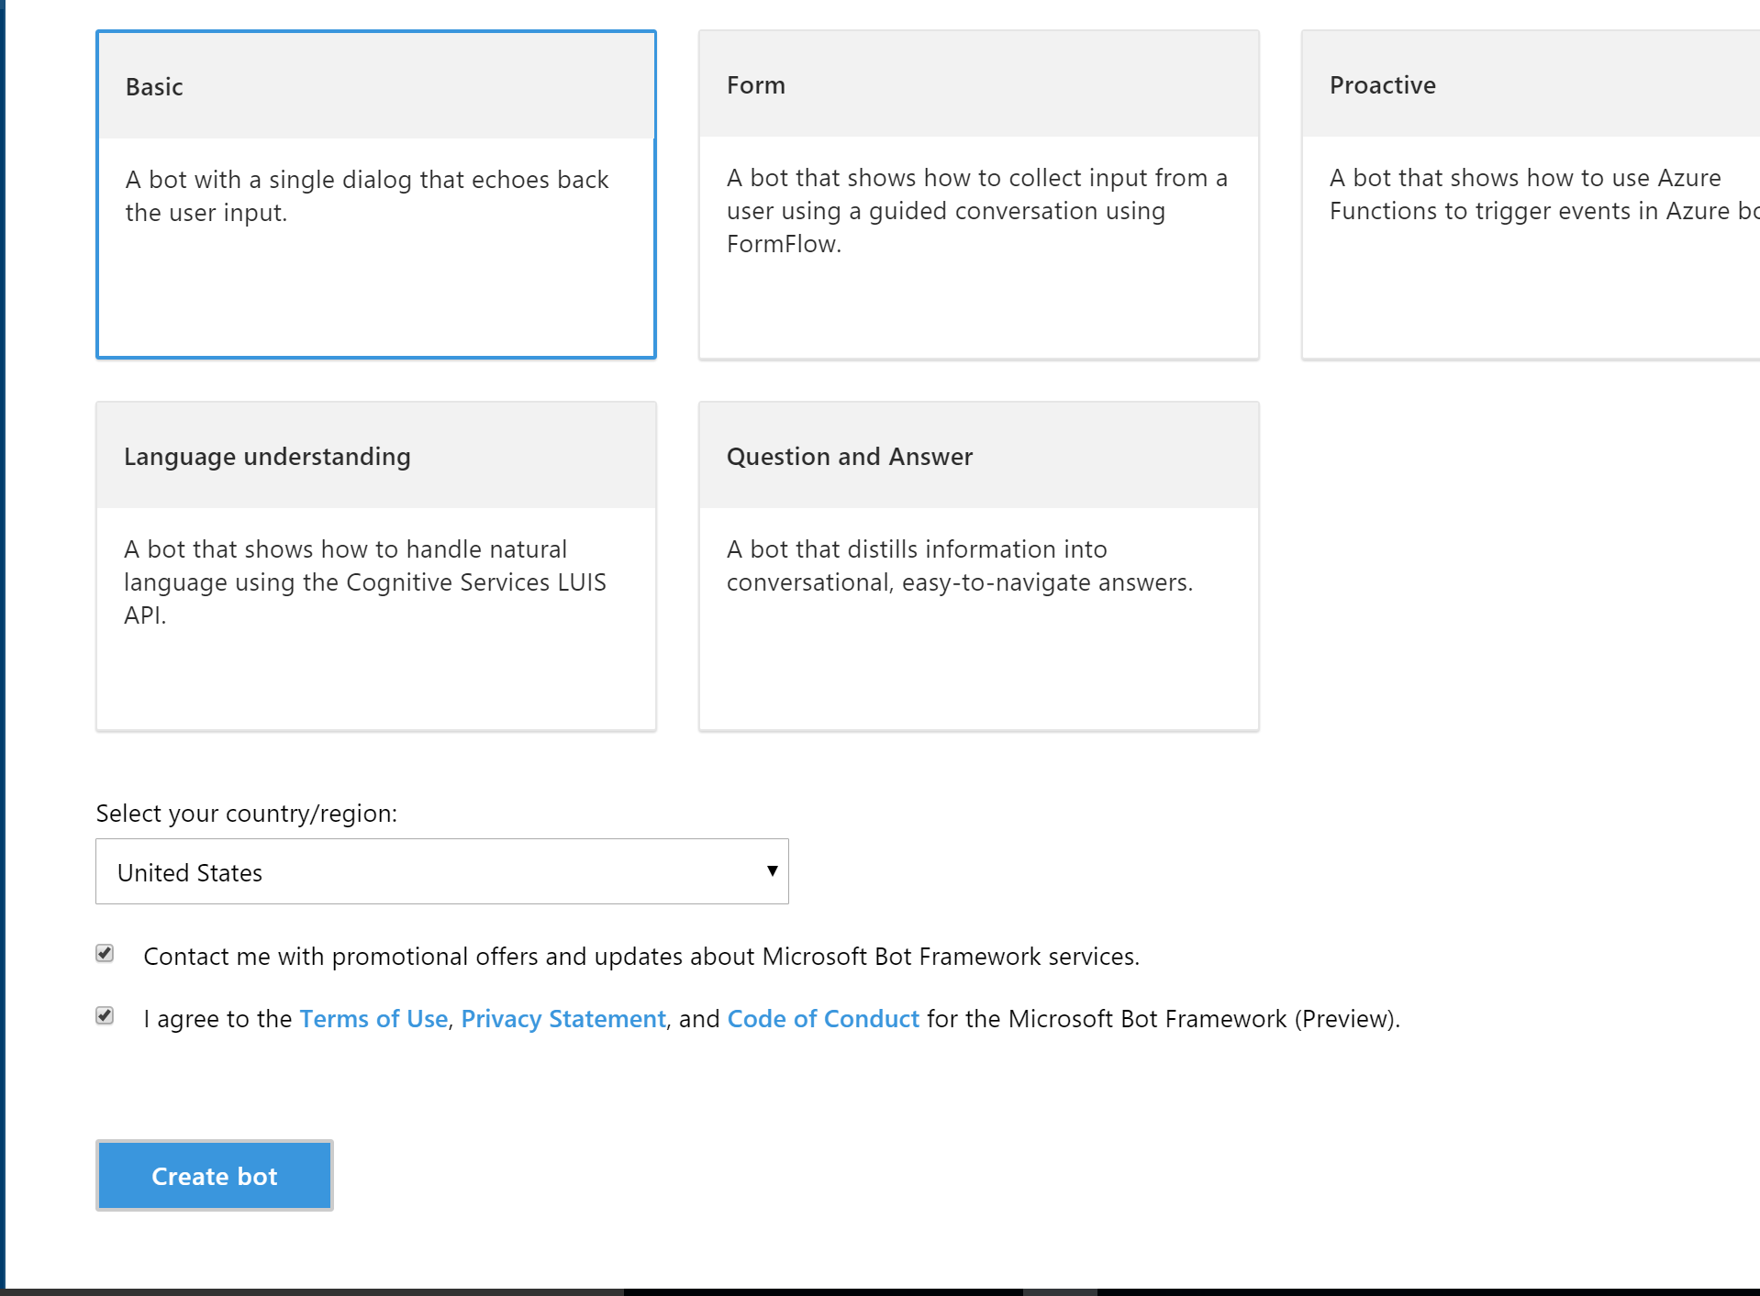

Slide 12
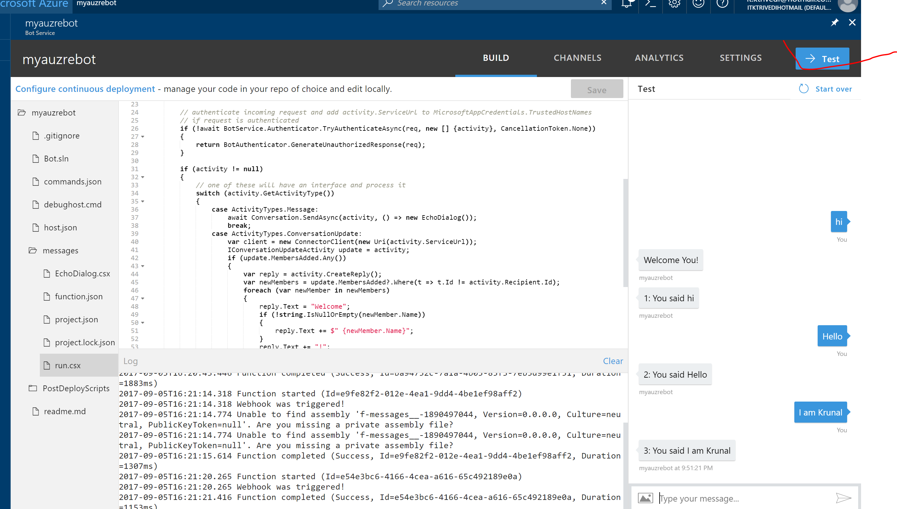
Click on Test. Give some sample input and run your application.

